Slide 1


SAS Big Data Committee Presents:
Introduction to Python
Presented on 31st October 2017 by Karthikan S/O Selvaraj and Huang Guoyu

Slide 2

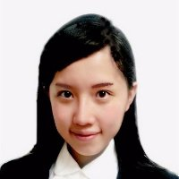
HELLO!
Karthik
Nanyang Technological University
Major in Actuarial Science, minor in Entrepreneurship
Guoyu
Valuation Actuarial Assistant at Munich Re
National University of Singapore
B.Sc. (Hons), Statistics, Mathematics, Economics

Slide 3
Contents
Introduction to Python
Set up and Installation
Jupyter Notebooks
Introduction to Pandas
Data exploration in Pandas
Loss triangles in Pandas
Introduction to Matplotlib and Seaborn
Data visualisation
COOL STUFF

Slide 4
Python
Web and Internet Development
Software Development
An interpreted, object-oriented, high-level programming language with dynamic semantics
Research and education
Data Science

Slide 5
Why Python when I can use Excel?

Slide 6
What about Python vs R then?

Slide 7
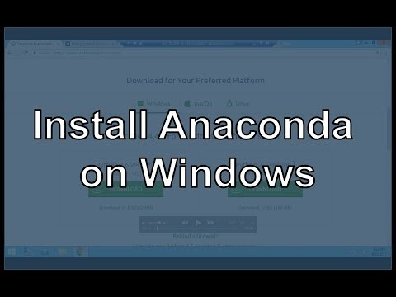

Slide 8

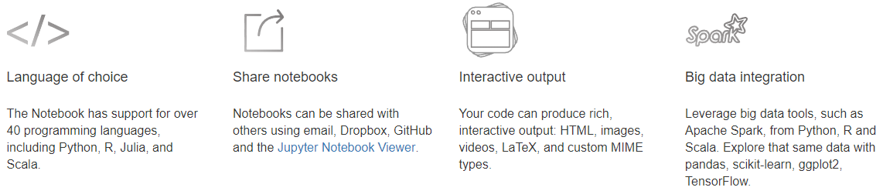

Slide 9
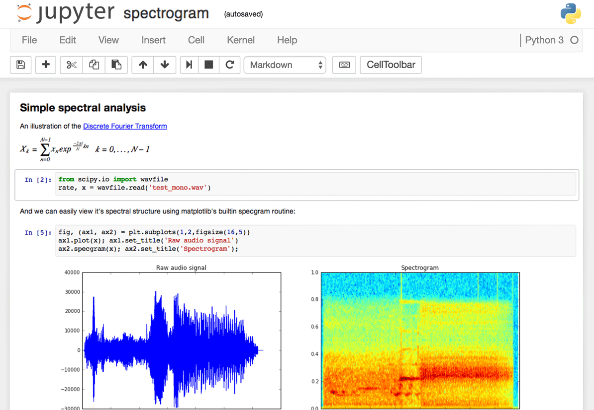
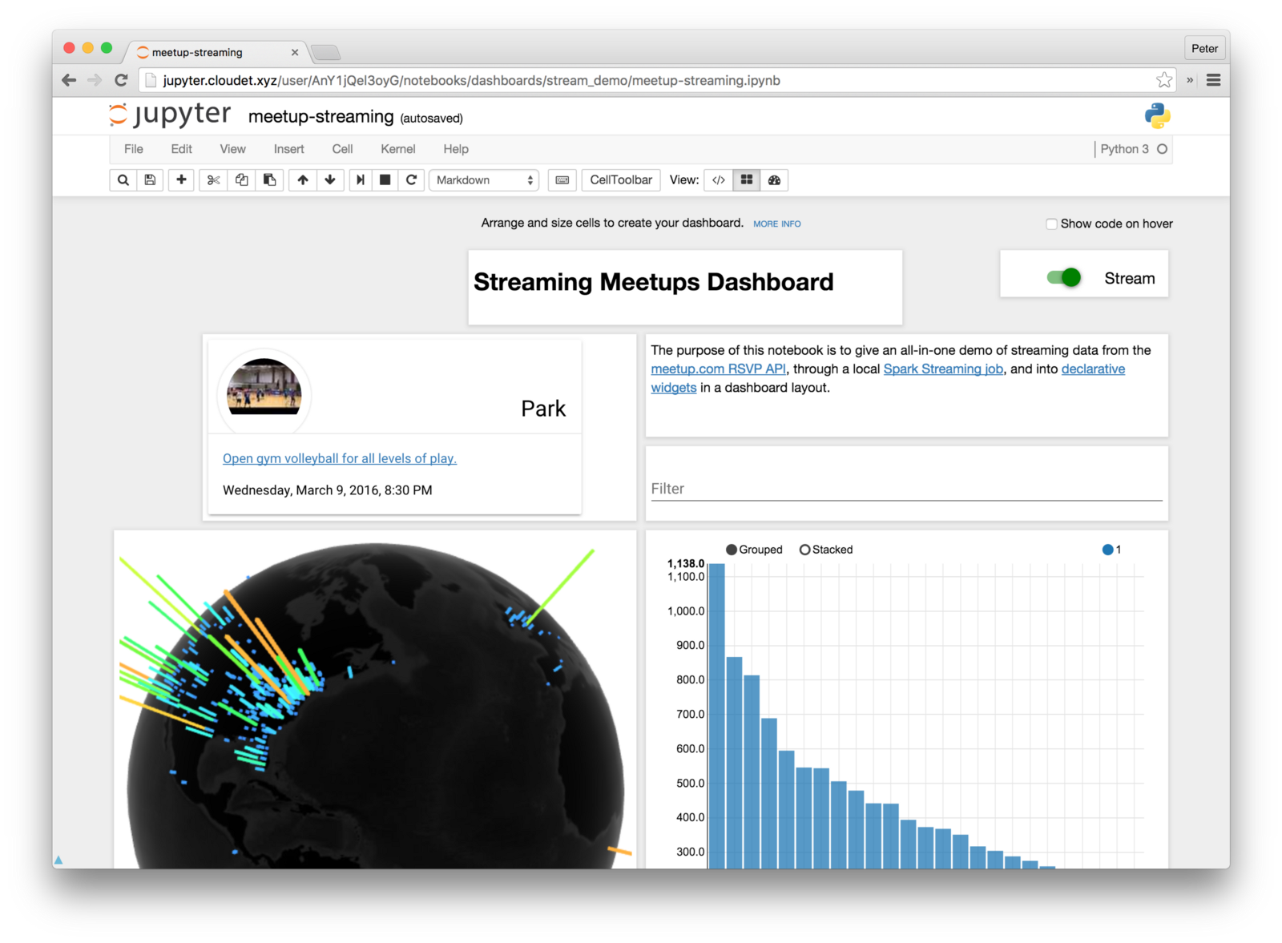
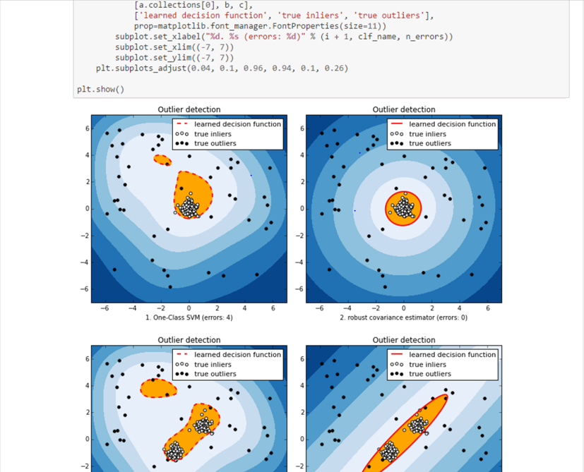

Slide 10
Lets fire up a
notebook!

